Slide 1
Digital Stress and Mental Health Across Time Among Peruvian Adolescents
Daniela E. Muñoz Lopez

Slide 2
Background

Slide 3
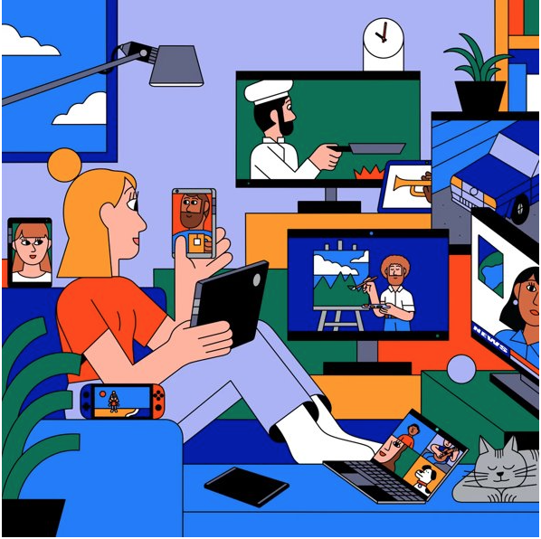
Adolescents and Digital Media Use
Adolescence is a critical developmental period characterized by social and emotional learning that shapes identity development
For adolescents, being online has allowed for more sociability & connectivity opportunities
Online only friendships
During adolescence there is a lot of
Attention to social sensitivity
Concern with what others think about you
Magis-Weinberg et al., 2021; Nelson et al., 2016; Nielson et al., in prep; Reid Chassiakos et al., 2016
Notes:
For this study, I was interested in exploring digital stress among adolescents for various reasons….
After concern: CONNECT TO DSS → SO, IF MANAGING FEELINGS OF DSS IS HARD FOR US, IMAGINE HOW AMPLIFIED THIS IS FOR ADOLESCENCE WHO ARE GOING THROUGH VARIOUS DEVELOPMENTAL TASKS
We know there is a dependency on tech for connection

Slide 4
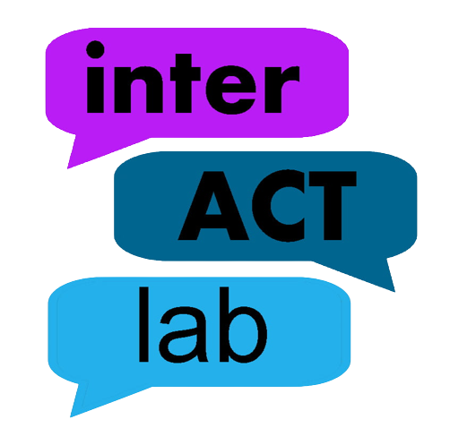
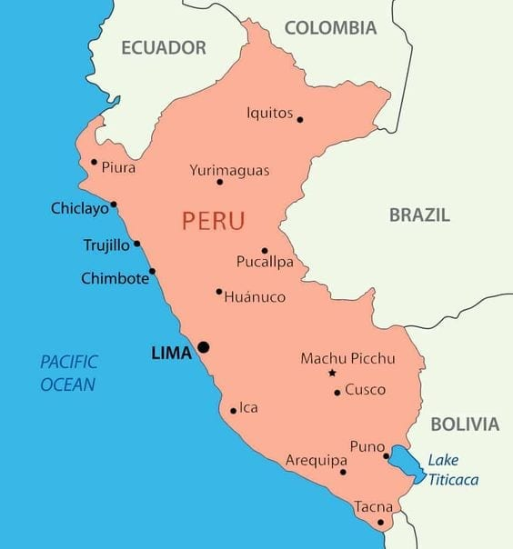
Digital Media Use and COVID-19 for Adolescents in Perú
Little research on the frequency and intensity of digital media use in the global south
Most studies focus on general device access and digital skills while fewer studies explore the relationship between digital media use and wellbeing
Stringent lockdown in Perú
Two full years of remote instruction
Data has shown effects of COVID-19 on adolescents in Peru
Ghai et al., 2022; Magis-Weinberg et al., 2021; Magis-Weinberg et al., under review; Matassi & Boczkowski, 2020; Nelson et al., 2016
Notes:
In the interACT lab, we are interested in capturing the experienced of youth growing up in the majority world, or the global south, specifically Latin America because…
***Perú, positive experiences with SMU (e.g., getting help online) were associated with less loneliness during the pandemic, with reverse patterns for the negative experiences with SMU
Before stringent lockdown
- FOMO and social networking intensity mediates the association between mental health symptoms and negative online consequences

Slide 5
Cross-Sectional Study
Digital Stress
Perceived Stress
Symptoms of Anxiety
Symptoms of Depression
Peruvian Adolescents during COVID-19

Slide 6
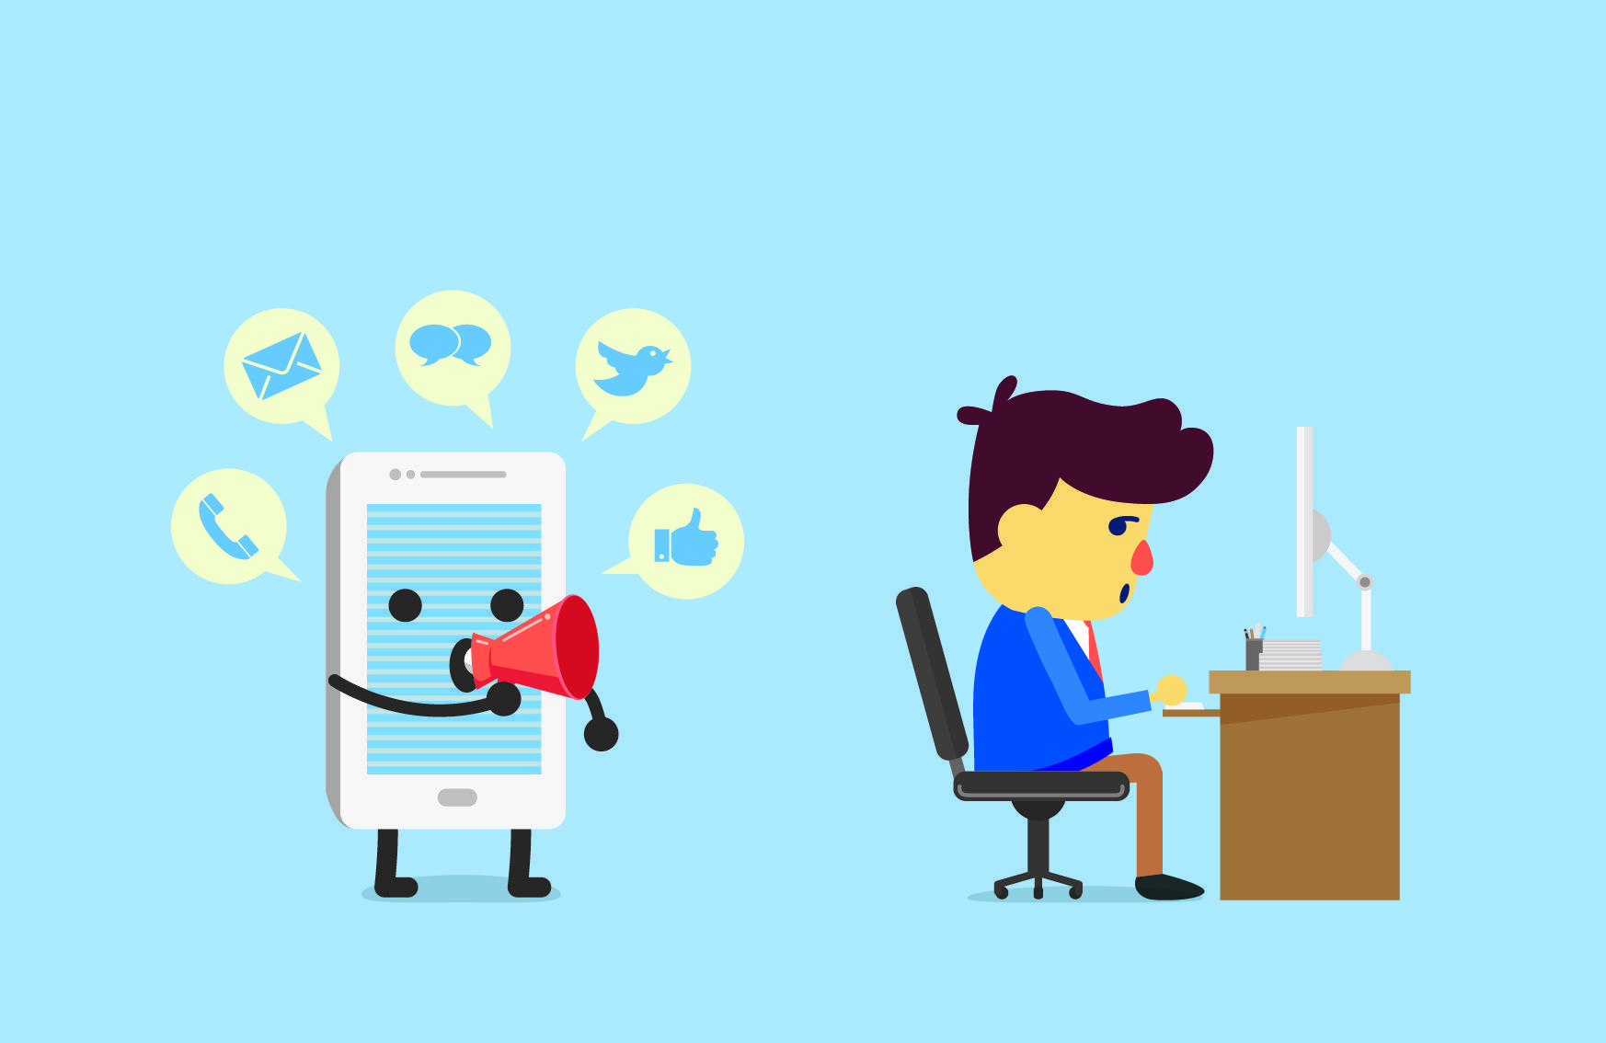
Digital Stress
Connection overload
Fear of Missing Out (FOMO)
Availability Stress
Approval Anxiety
Online Vigilance
Steele et al. 2020; Hall et al. 2021
Notes:
If you have felt any of these things, you have endorsed subjective ratings of digital stress.
Digital Stress is a subjective experience characterized by a person’s own response to distressing events occurring online.
These numerous facets of digital stress may be playing a role in the association between social media use & psychological outcomes among adolescents.

Slide 7
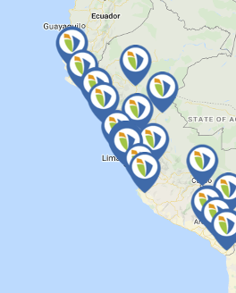
Methods
Collected data during week 68 of lockdown in Perú: June 28th, 2021
Collected self-report data on perceived stress, symptoms of anxiety, and symptoms of depression
Administered the Digital Stress Scale (DSS; Hall et al. 2020)
Culturally adapted
Validated this using EFA & CFA
Ran linear models to explore associations between variables of interest
Notes:
64 schools
add visual explaining the adaptation of the culturally adapted scale – TO DO
Re-arrange
Data collected during
Type of data collected
Analyses
Efa/CFA
LM

Slide 8
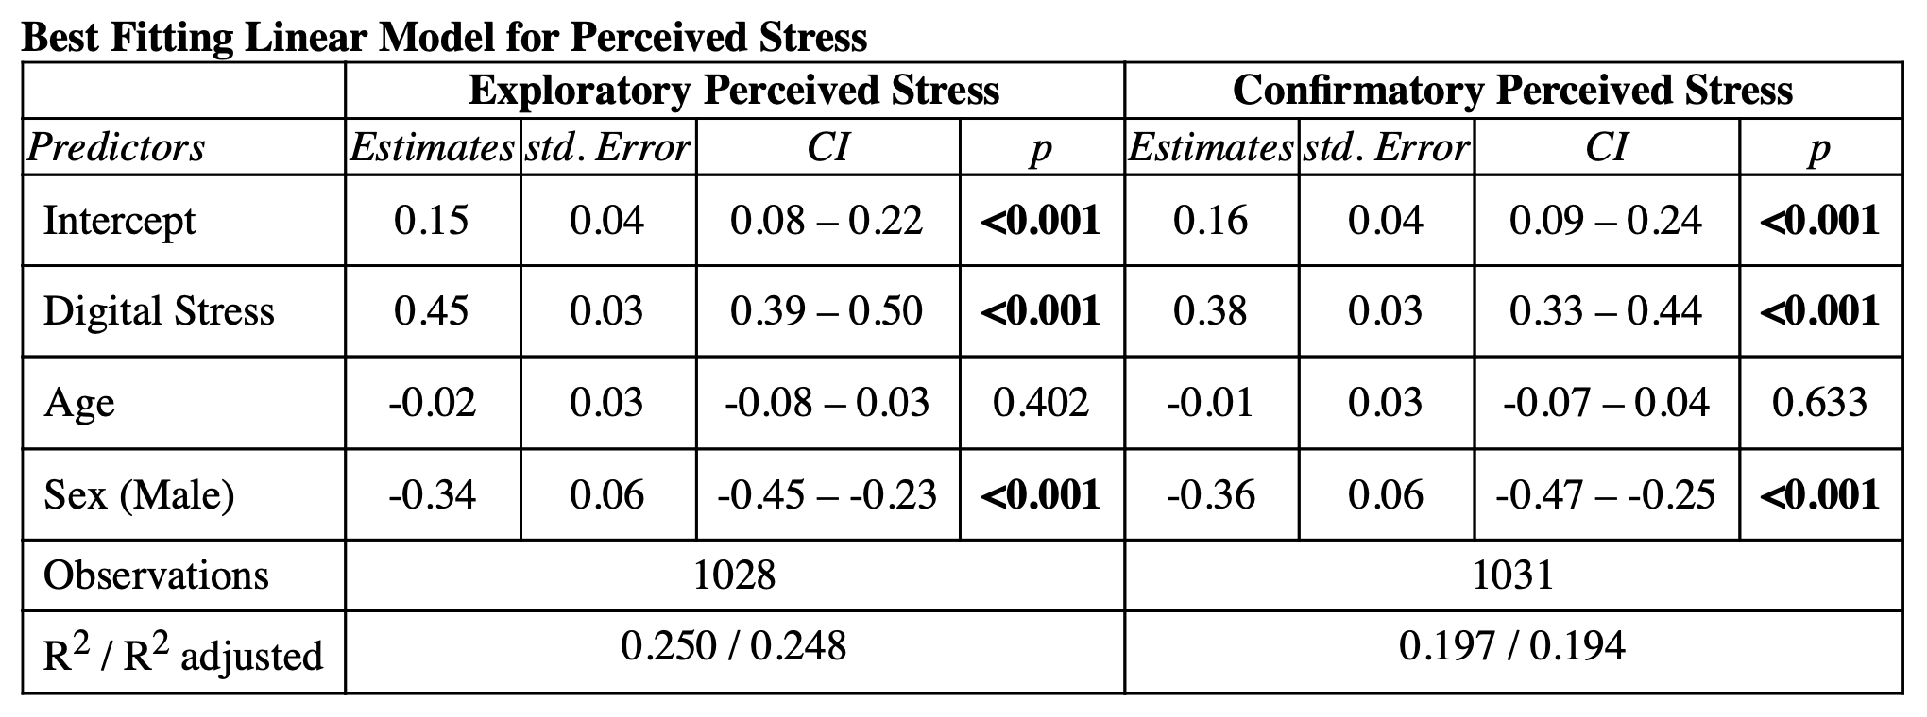
Digital stress is associated with higher perceived stress

Slide 9
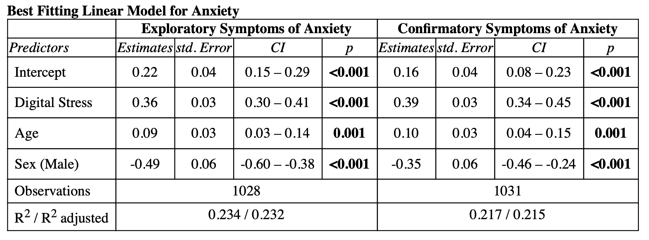
Digital stress is associated with higher symptoms of anxiety

Slide 10
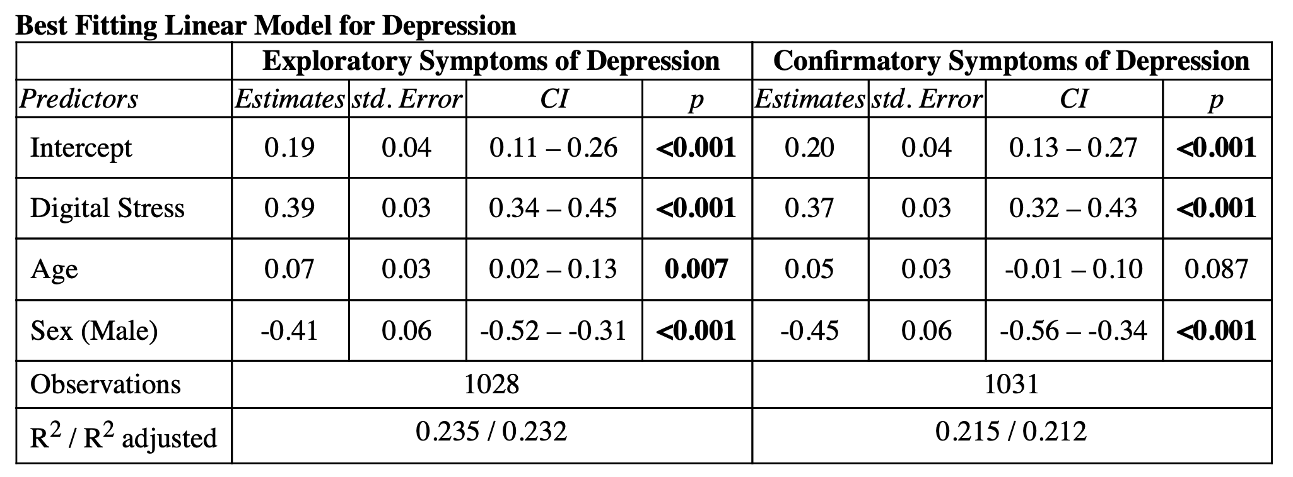
Digital stress is associated with higher symptoms of depression

Slide 11

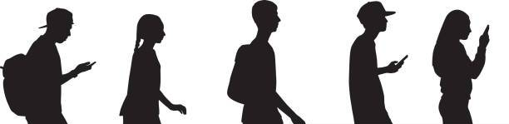
Adolescent girls & older adolescents endorsed more digital stress, perceived stress, and symptoms of anxiety & depression
Notes:
Adolescent girls and older adolescents endorse more digital stress
This is related to symptoms of stress, anxiety, and depression.
- include better transition next

Slide 12
The Current Study

Slide 13
Digital Stress and Mental Health Across Time: A Follow Up
We aimed to explore:
1. If digital stress increased from Time 1 (June 2021) to Time 2 (November 2021)
2. If baseline mental health vulnerabilities (anxiety and depression) at Time 1 predict increases in digital stress at Time 2

Slide 14
Methods
Collected data during week 68 of lockdown in Perú: June 28th, 2021
Additional data from week 87 of lockdown in Perú: November 8th, 2021
Administered the Digital Stress Scale (DSS; Hall et al. 2020)
Culturally adapted
Administered PROMIS Anxiety & PROMIS Depression
Mixed-effect models to explore associations between variables of interest
Notes:
64 schools
add visual explaining the adaptation of the culturally adapted scale – TO DO
Re-arrange
Data collected during
Type of data collected
Analyses
Efa/CFA
LM

Slide 15
Sample Characteristics
N = 973
Time 1 N = 496
Time 2 N = 477
64.2% female
Ages 11 – 17 (Mean: 12.8; SD 1.5)

Slide 16
Measures

Slide 17
Clinical Ranking

Slide 18
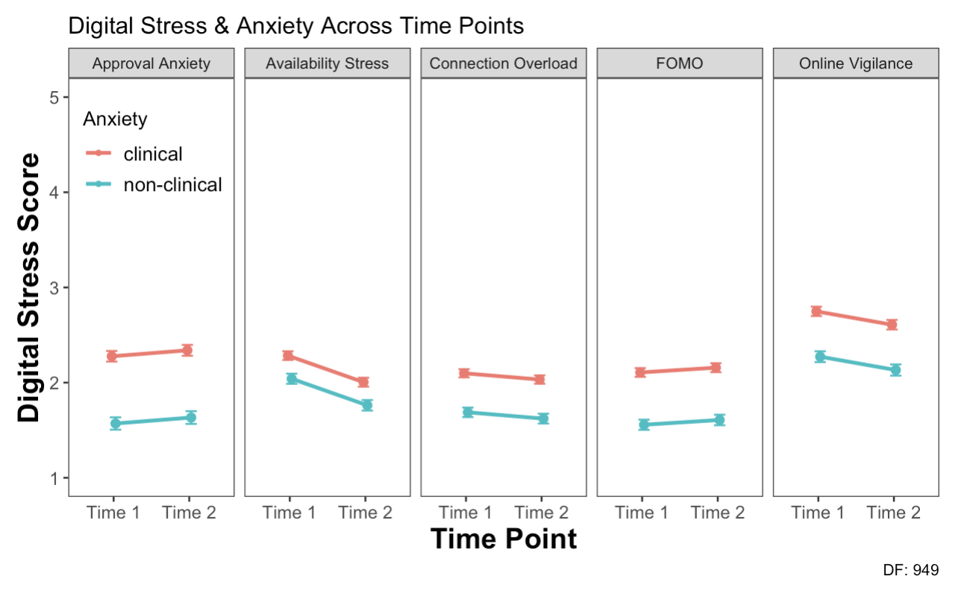

Slide 19
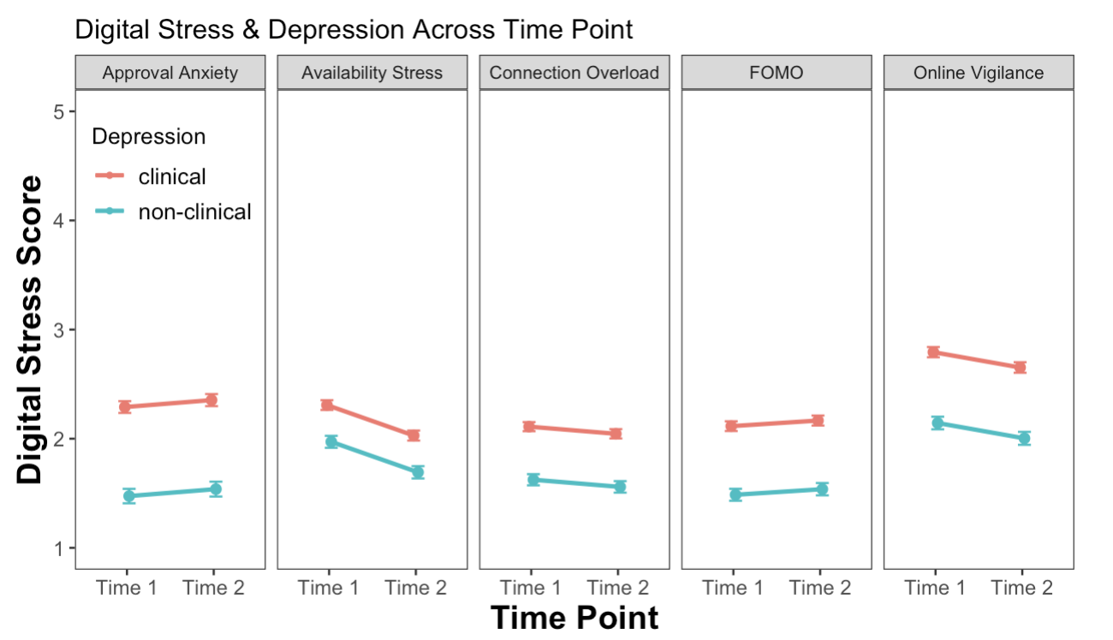

Slide 20
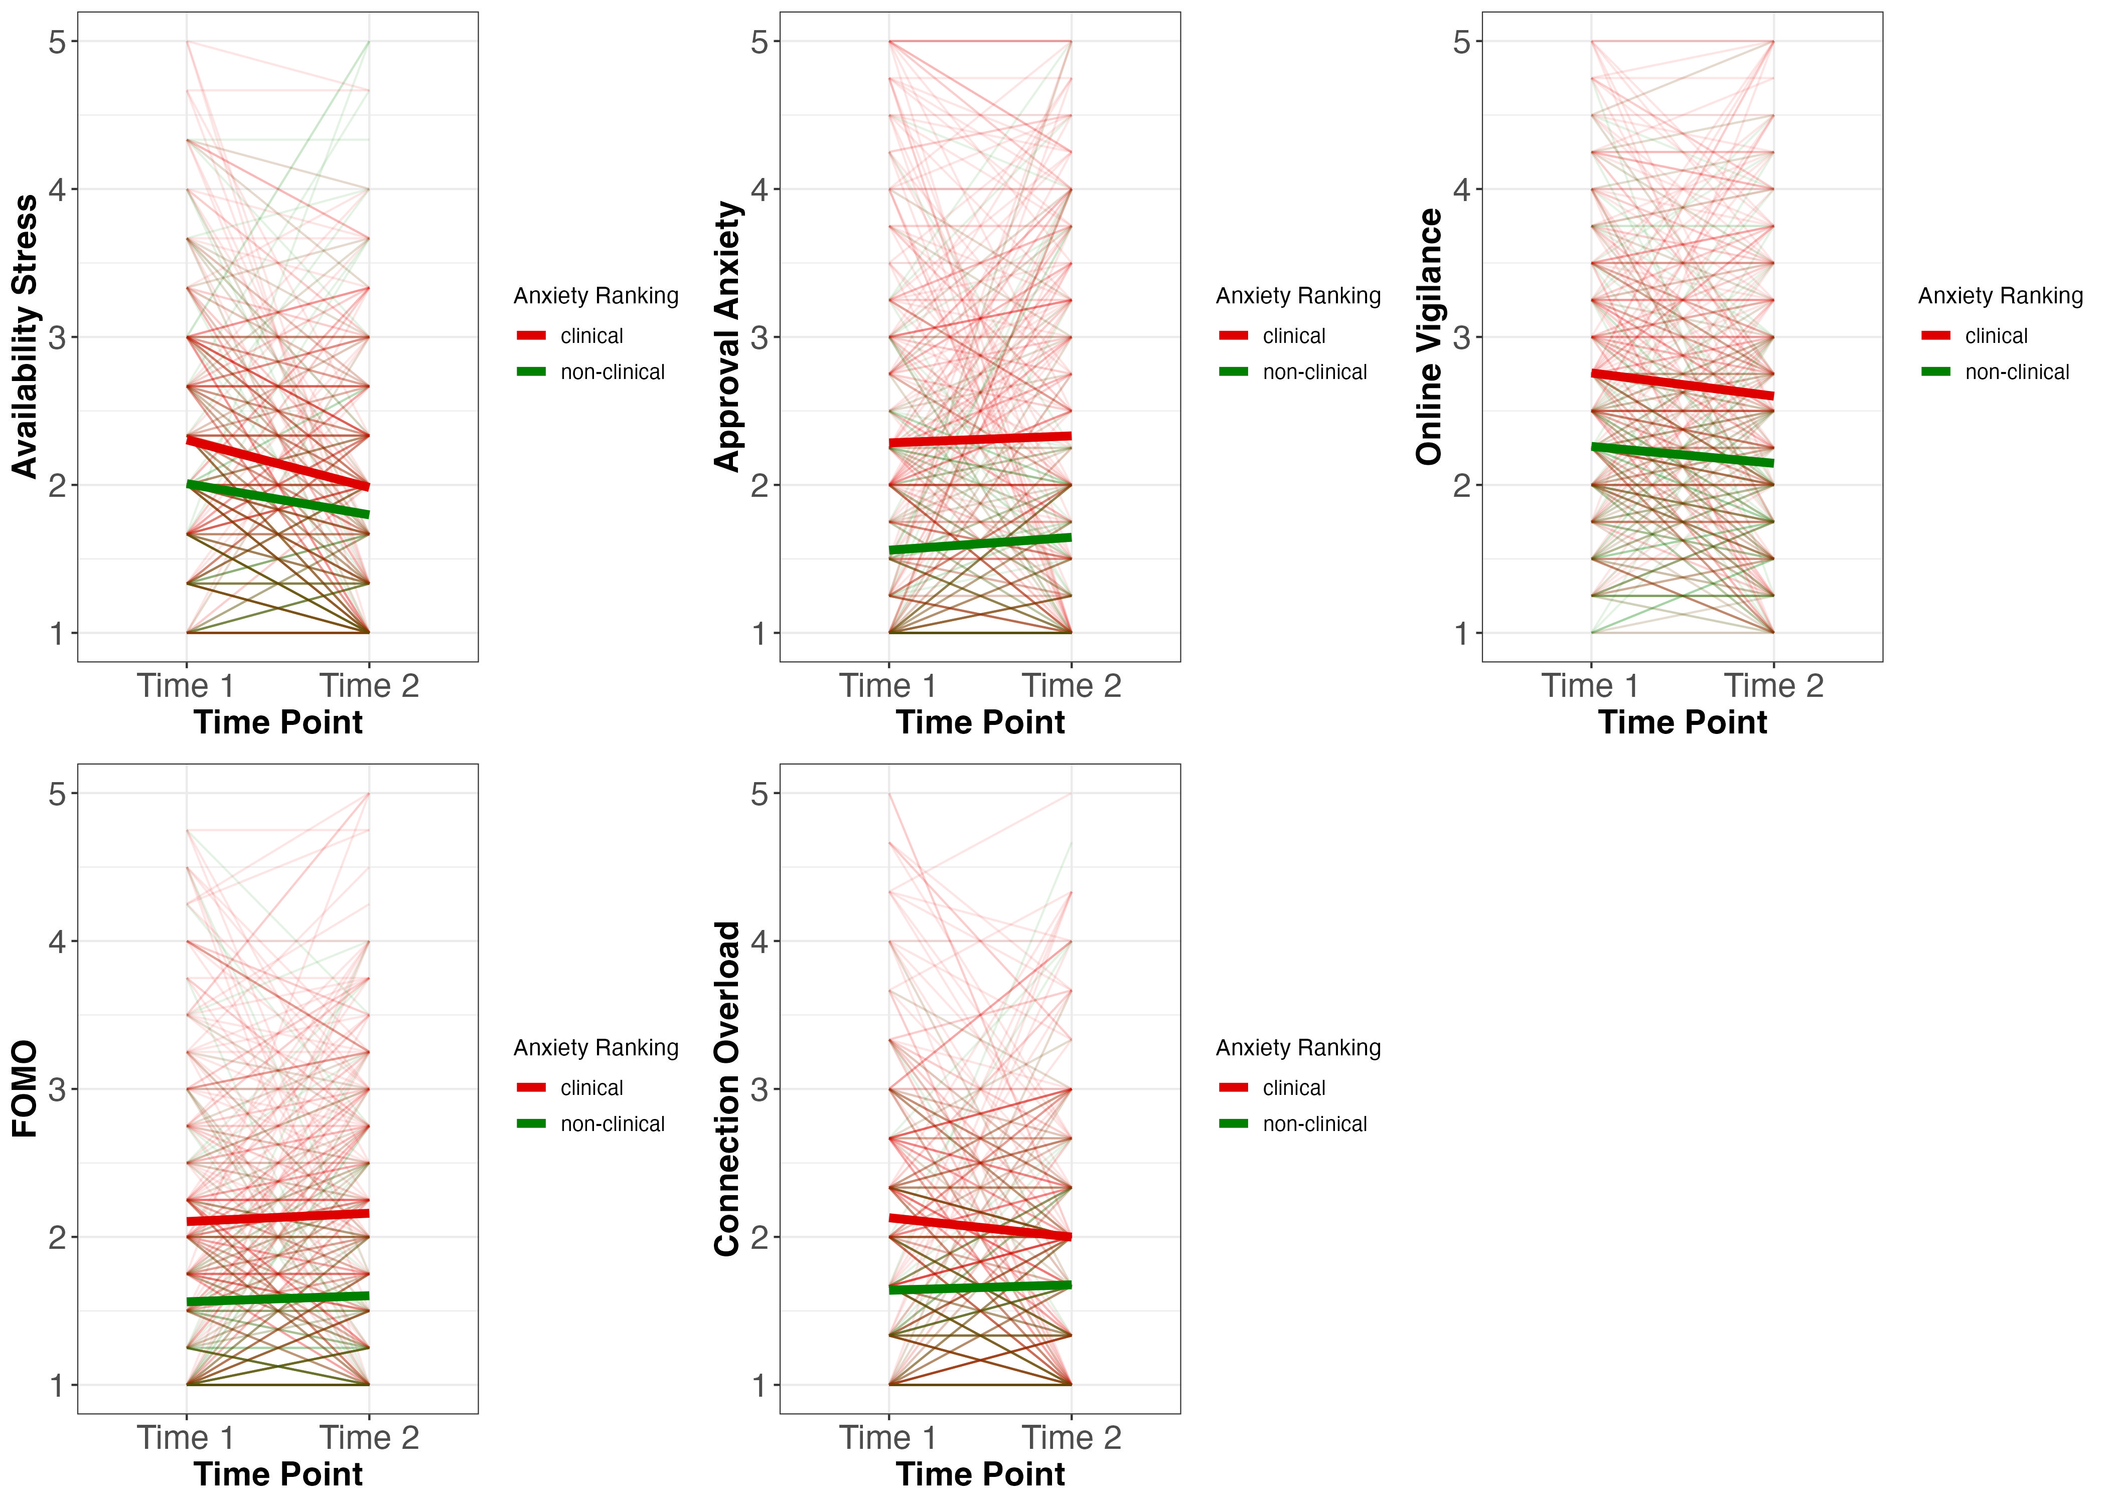
Anxiety

Slide 21
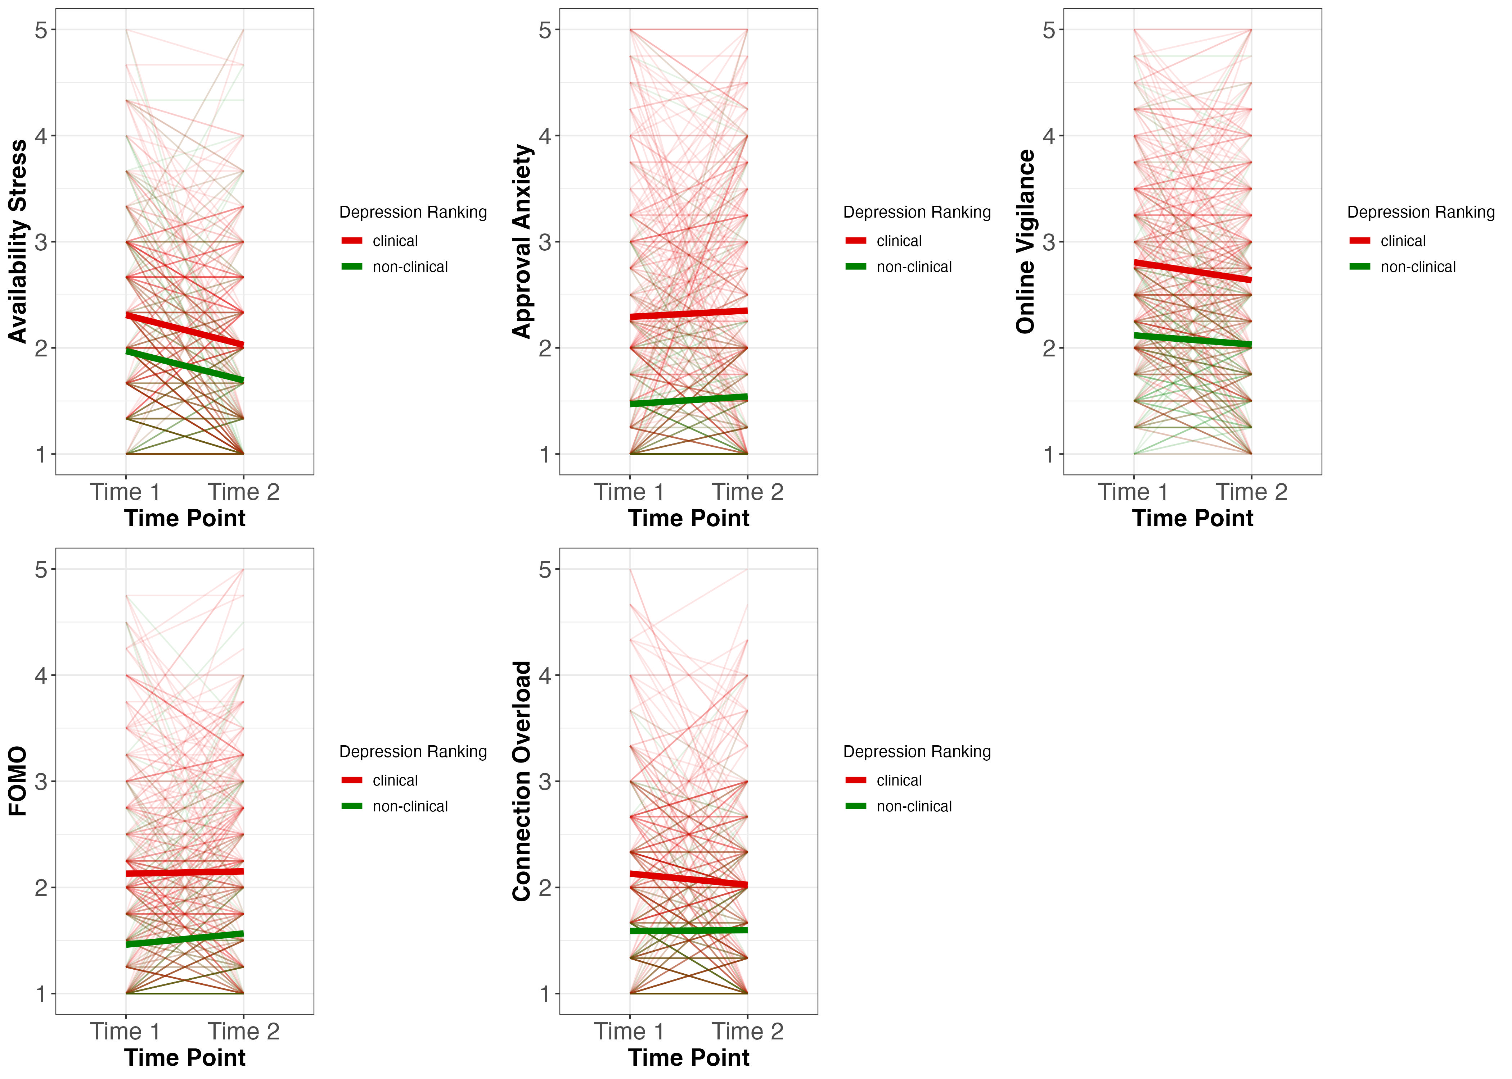

Slide 22


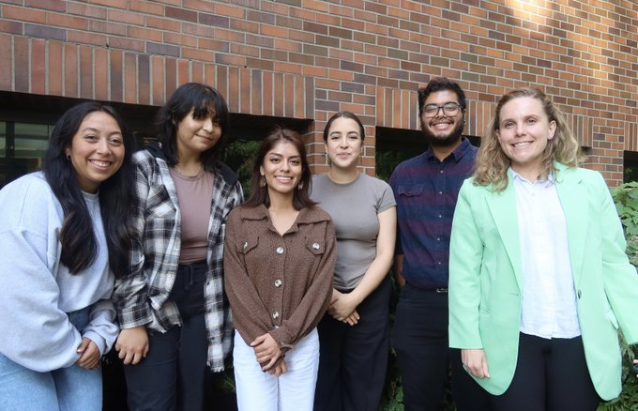
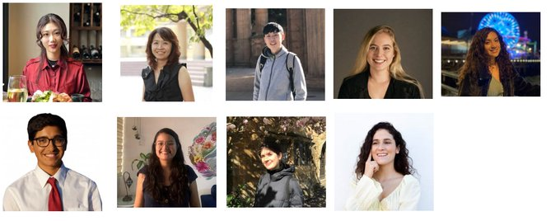
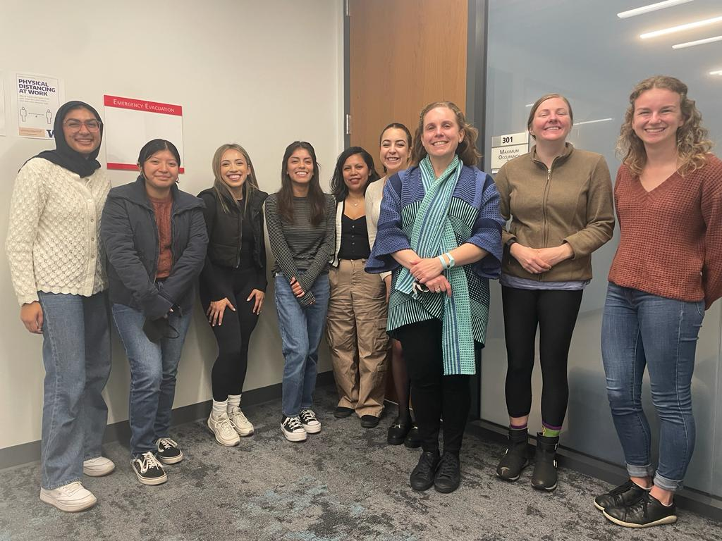
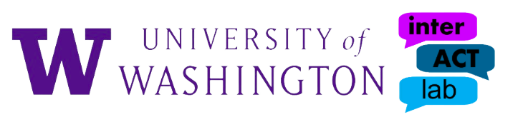
Advisors:
Dr. Lucía Magis-Weinberg & Dr. Kate Foster
interACT Lab members!

Slide 24
Severity Ranking
Depression | N | %
Severe | 356 | 25%
Moderate | 505 | 35%
Mild | 208 | 14.4%
Normal | 370 | 26%
Anxiety | N | %
Severe | 478 | 33.2%
Moderate | 670 | 47%
Mild | 82 | 5.7%
Normal | 209 | 14.5%
Notes:
Total n = 1439

